Slide 1
Introduction to
MATLAB (2)

Slide 2
Relational operators
Logical operators
Block if-else-end
Block switch-case-end
Loops: for, while
Functions
Global and local variables
3-D visualization

Slide 3
Relational operators
סימון | סוג ההשוואה
A<B | Aגדול מ-B
A>B | A קטן מ- B
A>=B | A גדול או שווה ל- B
A<=B | A קטן או שווה ל- B
A==B | A שווה ל- B
A~=B | A שונה מ- B

Slide 4
Logical operators
AND, OR, NOT
OR |
AND &
p | q | p |q
FALSE | FALSE | FALSE
FALSE | TRUE | TRUE
TRUE | FALSE | TRUE
TRUE | TRUE | TRUE
p | q | p&q
FALSE | FALSE | FALSE
FALSE | TRUE | FALSE
TRUE | FALSE | FALSE
TRUE | TRUE | TRUE
NOT ~
p | ~p
FALSE | TRUE
TRUE | FALSE

Slide 5
Block if-else-end
if condition
…
end
if condition
…
else
…
end
if condition1
…
elseif condition2
…
else
…
end

Slide 6
Block if-else-end
Example 1:
% if-else-end Block
t=0;
if t > 0
sgnt = 1;
else
sgnt = -1;
end
Example 2:
% if-elseif-end Block
if t > 0
sgnt = 1;
elseif t < 0
sgnt = -1;
end
Example 3:
% if-elseif-else-end Block
if t > 0, sgnt = 1;
elseif t < 0, sgnt = -1;
else sgnt = 0
end

Slide 7
Block if-else-end
Example 4:
% if-else-end Block
point=85;
if point >= 90, grade = ‘A’
else point >=80, grade=‘B’
else point >=70, grade=‘C’
else point >=60, grade=‘D’
else , grade =‘F’
end

Slide 8
Block switch-case-end
switch expression
case value 1
…
case value 2
…
otherwise
…
end

Slide 9
Block switch-case-end
Example 5:
point=85;
switch floor(point/10) %floor(x):integer less than or equal to x
case 9, grade = ‘A’
case 8, grade=‘B’
case 7, grade=‘C’
case 6, grade=‘D’
otherwise grade =‘F’
end

Slide 10
Loop for
for count = start: step: final
…
end;
>>S = 0;
for k = 1:1:50
S = S+1/k^2;
end;

Slide 11
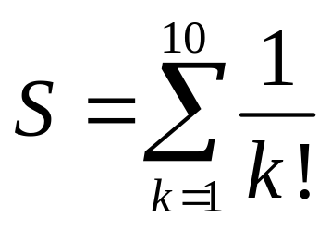
Loop for
Calculate:
S=0;
for k=1:10
S=S+1/factorial(k);
end
S

Slide 12
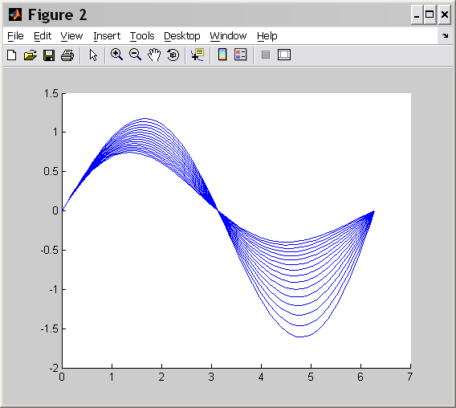
Loop for
figure
x=0:pi/30:2*pi
for a=-0.1:0.02:0.2
y=exp(-a*x).*sin(x);
hold on
plot(x,y)
end

Slide 13
Loop for
Example 6:
point=[76 91 54 35 87];
for n = 1: length(point)
if point(n) >= 55, pf(n,:) = 'pass';
else pf(n,:) = 'fail';
end
end
pf
Result:
pf =
pass
pass
fail
fail
pass

Slide 14
Loop while
while condition
…
end
>>S=0; k=1; u=1;
while u>1e-3 %10^(-3)
S = S+u;
k = k+1;
u = 1/k^2
end

Slide 15
Loop while
Example 7:
prod = 1; i=1;
while 1
prod=prod*i;
i=i+1;
if i>8
break
end
end
Result:
>> I
i = 9
>> prod
prod = 40320

Slide 16
Loop while
Example 8:
r = 1;
while r < 10
r = input(‘\nType radius (or nonpositive) ’)
if r <= 0 , break, end %isempty(r)|r<=0,break,end
vol=4/3*pi*r*r*r;
fprintf(‘\n\a The volume of a sphere with radius %3.1f = %8.2f\n’, r, vol);
end

Slide 17
Function M-files
File named sumN.m :
function s = sumN(x,N)
s=0;
u=1;
for m=1:N
u=u.*x/m;
s=s+u;
end
>> S=sumN(1.5,10)
Result:
S = 3.4817

Slide 18
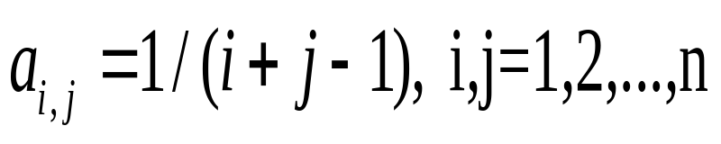
Function M-files
Calculate
File Hlb.m :
function H = Hlb(n)
A=zeros(n);
for i=1:n
for j=1:n
A(i,j)=1/(i+j-1);
end
end
A
result:
>> Hlb(3)
A = 1.0000 0.5000 0.3333
0.5000 0.3333 0.2500
0.3333 0.2500 0.2000

Slide 19
Function find()
a=[3 4 5 6;2 3 4 5;5 1 2 8]
>> [i,j] = find(a>4)
i = 3
1
1
2
3
a = 3 4 5 6
2 3 4 5
5 1 2 8
j = 1
3
4
4
4
>> k = find(a>4)
k= 3 7 10 11 12

Slide 20
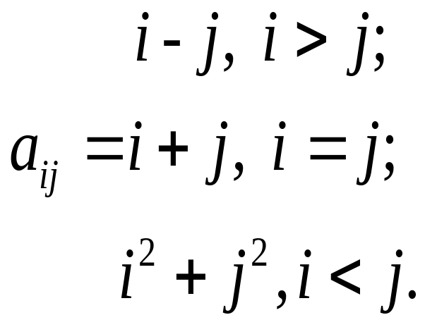
Function M-files
File matr.m:
function H = matr(n)
A=zeros(n);
for i=1:n
for j=1:n
if i>j
A(i,j)=i-j;
elseif i==j
A(i,j)=i+j;
else
A(i,j)=i^2-j^2;
end
end
end
A
>> matr(3)
A = 2 -3 -8
1 4 -5
2 1 6

Slide 21
Function M-files
File matr.m:
function [A,Max,Min] =mm(n)
A=10*rand(n);
Max=max(max(A))
Min=min(min(A))
[imax,jmax] = find(A==Max);
[imin,jmin] = find(A==Min);
fprintf('A(%d,%d)=%.4f A(%d,%d)=%.4f', imax,jmax,Max, imin,jmin,Min)
A;
>> [A,Max,Min]=mm(3)
A =
3.1269 6.8312 6.1240
0.1286 0.9284 6.0854
3.8397 0.3534 0.1576
Max = 6.8312
Min = 0.1286

Slide 22
Variables
Each MATLAB M-file function has its own local variables,
which are separate from those of other functions. However, if several functions, and possibly the base
workspace, all declare a particular name as global, they all
share a single copy of that variable.
global X Y Z %defines X, Y, and Z as global
If the global variable does not exist the first time you issue
the global statement, it is initialized to the empty matrix.

Slide 23
Importing and exporting data
For example the file named my_data.txt contains
1 2 3 4 5
6 7 8 9 10
When we use load it imports the data and creates a variable in the workspace:
load my_data.txt;
my_data =
1 2 3 4 5
6 7 8 9 10
A = load(‘my_data.txt’);

Slide 24
Importing delimited ASCII data files
For example, consider a file named ph.dat contains
7.2; 8.5; 6.2; 6.6
5.4; 9.2; 8.1; 7.2
To read the entire contents of this file into an array:
A = dlmread(‘ph.dat’, ‘ ; ’);

Slide 25
Importing numeric data with text headers
To import an ASCII data file that contains text headers, use the textread function. For example, consider a file named grades.dat contains
grade1 grade2 grade3
78.8 55.9 45.9
99.5 66.8 78.0
To import this data use the command:
[grade1 grade2 grade3] = textread(‘grades.dat’, ‘%f %f %f ‘, ‘headerlines’, 1)
grade1 = grade2 = grade3 =
78.8 55.9 45.9
99.5 66.8 78.0

Slide 26
Importing mixed alphabetic and numeric data
To import an ASCII data file that contains text headers, use the textread function. For example, the file mydata.dat contains a mix of data
Sally type1 12.34 45 yes
Larry type2 34.45 87 no
To import this data use the command:
[names, types, x, y, answer] = textread(‘mydata.dat’, ‘%s %s %f %d %s’, 2)
names = types = x= y= answer =
‘Sally’ ‘type1’ 12.34 45 ‘yes’
‘Larry’ ‘type2’ 34.45 87 ‘no’

Slide 27
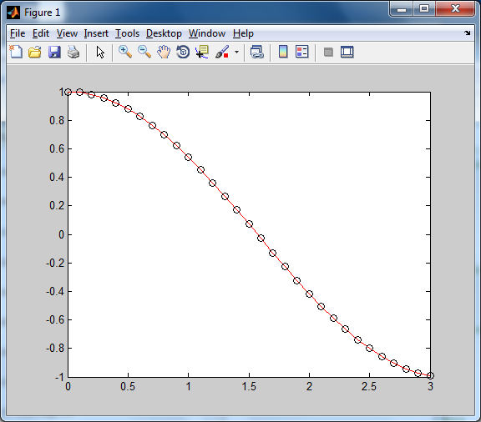
2-D visualization. Graphics
>> x = 0: 0.1:3;
>> y = cos(x);
>> plot(x, y, ’r-’, x, y, ‘ko’)

Slide 28
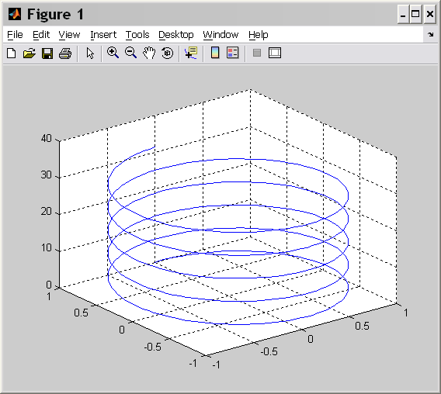
3-D visualization. Graphics
>> t = 0: pi/50:10*pi;
>> x = sin(t);
>> y = cos(t);
>> plot3(x,y,t)
>> grid on

Slide 29
3-D visualization. Graphics
>> x = -2: 0.1: 2;
>> y = -1: 0.1: 1;
>> [X Y] = meshgrid(x,y)
>> Z = exp(-X.^2-Y.^2);
>> surf(X,Y,Z)
>> grid on

Slide 30
3-D visualization.
Function meshgrid()
Generate X and Y matrices for three-dimensional
plots
Example
x = 0 : 2
y = 3 : 5
>> [X Y]= meshgrid(x,y)
X =0 1 2
0 1 2
0 1 2
0 1 2
Y= 3 3 3
4 4 4
5 5 5
6 6 6

Slide 31
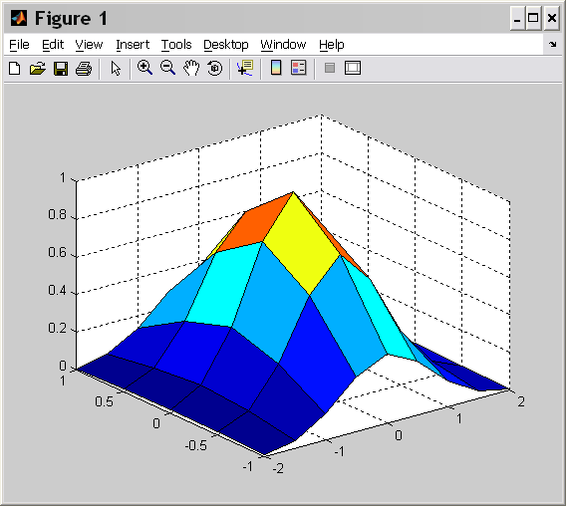
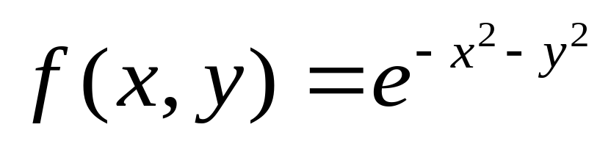
3-D visualization. Graphics

